Slide 1
Advanced Mixed Integer Programming Formulation Techniques Constructing MIP Formulations using Convex Hulls
Joey Huchette and Juan Pablo Vielma
Massachusetts Institute of Technology
Spring School of the International Symposium on Combinatorial Optimization (ISCO 2018)
Marrakesh, Morocco, April, 2018

Slide 2
Course Material
Code:
https://github.com/joehuchette/ISCO-spring-school/tree/master/code
Slides:
https://github.com/joehuchette/ISCO-spring-school/tree/master/slides

Slide 3
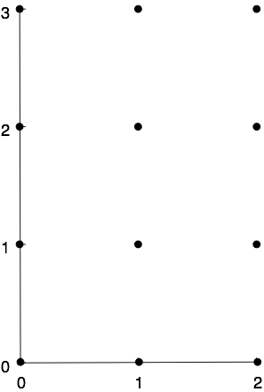
Constructing Ideal Formulations For Pure Integer
Pure Integer :
Ideal

Slide 4
Integral Formulations for Small Sets
$S=\left\{x∈{\left\{0,1\right\}}^{3} : x_{3}=x_{1} × x_{2}\right\}$
Constraints =
$S=\left\{\left(0,0,0\right), \left(1,0,0\right), \left(0,1,0\right),(1,1,1)\right\}$
:

Slide 5
Integral Formulations for Small Sets
julia> using Polyhedra, CDDLib, JuMP
julia> points = SimpleVRepresentation([0 0 0; 1 0 0; 0 1 0; 1 1 1]);
julia> poly = polyhedron(points, CDDLibrary(:exact))
julia> ineq = SimpleHRepresentation(poly)
H-representation
begin
4 4 rational
1//1 -1//1 -1//1 1//1
0//1 1//1 0//1 -1//1
0//1 0//1 1//1 -1//1
0//1 0//1 0//1 1//1
end
julia> model = Model(); @variable(model,x[1:3]);
julia> @constraint(model,convert.(Int64,ineq.A)*x .<= convert.(Int64,ineq.b))
4-element Array{JuMP.ConstraintRef{JuMP.Model,JuMP.GenericRangeConstraint{JuMP.GenericAffExpr{Float64,JuMP.Variable}}},1}:
x[1] + x[2] - x[3] ≤ 1
-x[1] + x[3] ≤ 0
-x[2] + x[3] ≤ 0
-x[3] ≤ 0

Slide 6
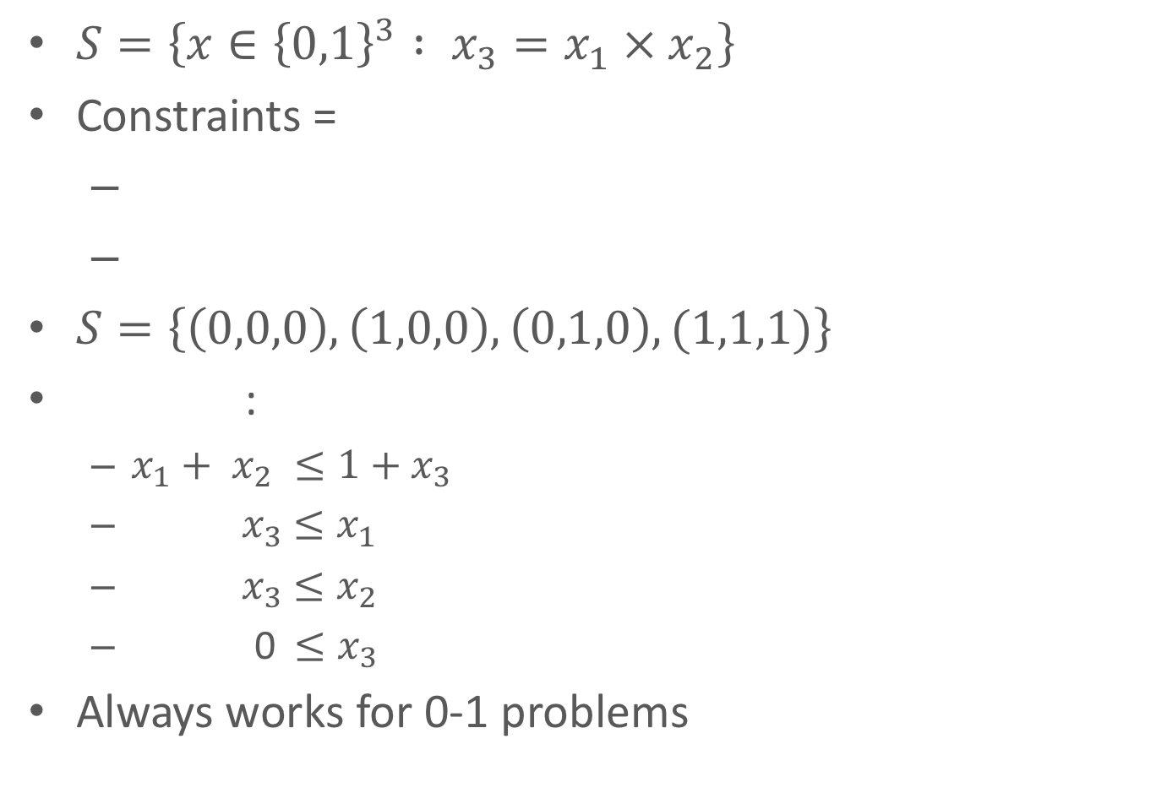
Integral Formulations for Small Sets
$S=\left\{x∈{\left\{0,1\right\}}^{3} : x_{3}=x_{1} × x_{2}\right\}$
Constraints =
$S=\left\{\left(0,0,0\right), \left(1,0,0\right), \left(0,1,0\right),(1,1,1)\right\}$
:
$x_{1}+ x_{2} ≤1+x_{3}$
${ x}_{3} ≤x_{1}$
${ x}_{3} ≤x_{2}$
0$≤x_{3}$
Always works for 0-1 problems

Slide 7
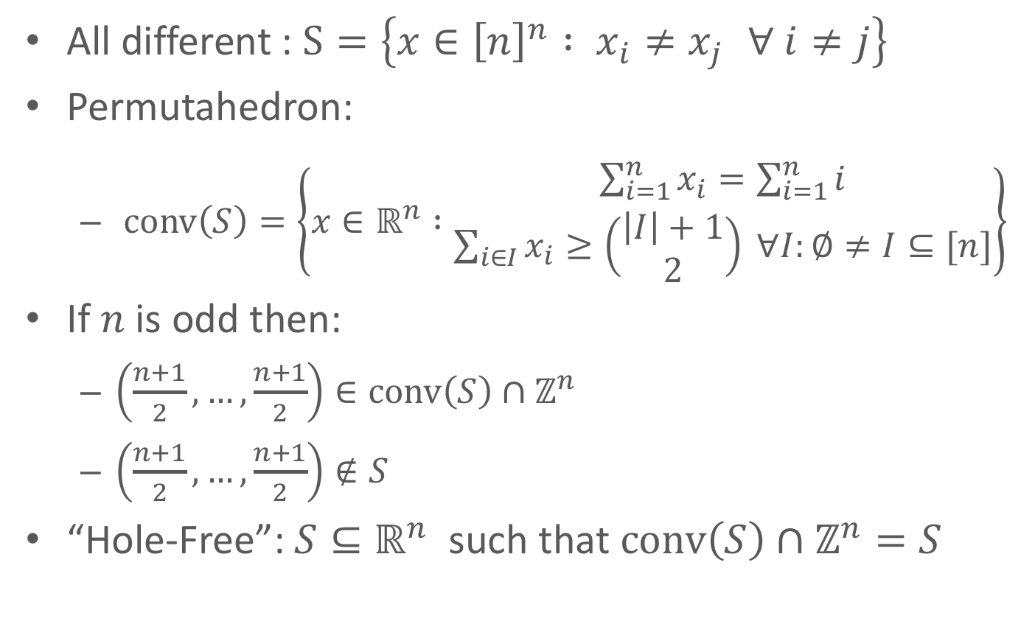
Careful With General Integer Problems
All different : $S=\left\{x∈{\left[n\right]}^{n} : x_{i}≠x_{j } ∀ i≠j\right\}$
Permutahedron:
$\operatorname{conv}\left(S\right)=\left\{x∈ℝ^{n} :\begin{matrix}\sum_{i=1}^{n}{x_{i}}=\sum_{i=1}^{n}{i} \\ \sum_{i∈I}{x_{i}≥\left(\begin{matrix}\left|I\right|+1 \\ 2\end{matrix}\right)} ∀I:∅≠I⊆[n]\end{matrix}\right\}$
If $n$ is odd then:
$\left(\frac{n+1}{2},…,\frac{n+1}{2}\right)∈\operatorname{conv}\left(S\right)∩ℤ^{n}$
$\left(\frac{n+1}{2},…,\frac{n+1}{2}\right)∉S$
“Hole-Free”: $S⊆ℝ^{n}$ such that $\operatorname{conv}\left(S\right)∩ℤ^{n}=S$

Slide 8
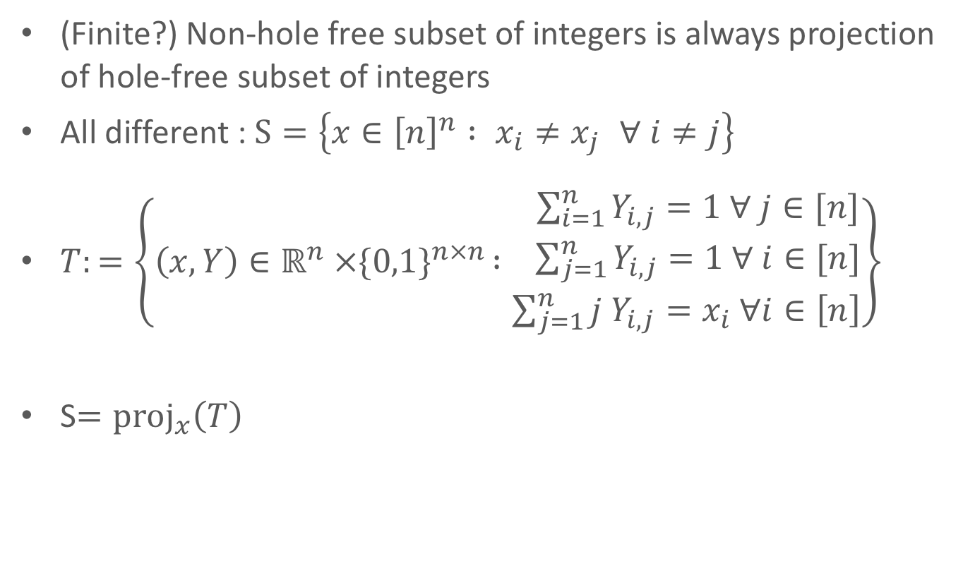
Solution: Extended Formulations
(Finite?) Non-hole free subset of integers is always projection of hole-free subset of integers
All different : $S=\left\{x∈{\left[n\right]}^{n} : x_{i}≠x_{j } ∀ i≠j\right\}$
$T:=\left\{\left(x,Y\right)∈ℝ^{n} ×{\{0,1\}}^{n×n } :\begin{matrix} \sum_{i=1}^{n}{Y_{i,j}}=1 ∀ j∈[n] \\ \begin{aligned} \sum_{j=1}^{n}{Y_{i,j}}=1 ∀ i∈[n] \\ {\sum_{j=1}^{n}{{j Y}_{i,j}}=x}_{i} ∀i∈\left[n\right]\end{aligned}\end{matrix}\right\}$
S$={proj}_{x}\left(T\right)$

Slide 9
What About Mixed-Integer Sets?
Pure Integer
Mixed-Integer

Slide 10
What is a MIP Formulation?

Slide 11
Simple Formulation for Univariate Functions
Non-Ideal: Fractional Extreme Points

Slide 12
Advanced Formulation for Univariate Functions
Ideal: Integral Extreme Points

Slide 13
Computational Performance
Advanced formulations provide an computational advantage
Advantage is significantly more important for free solvers
State of the art commercial solvers can be significantly better that free solvers
Still, free is free!

Slide 14
Formulation Improvements can be Significant
Simple
Advanced
GUROBI

Slide 15
Abstracting Univariate Functions
Special Ordered Sets of Type 2 (SOS2)

Slide 16
Abstraction Works for Multivariate Functions

Slide 17
Standard Formulation for SOS2 = Unary Encoding
= LP relaxation
Unary Encoding

Slide 18
Advanced = Binary Encoded Formulation
= LP relaxation
V. and Nemhauser ’08.
Binary Encoding

Slide 19
Embedding Formulation = Ideal non-Extended
(Cayley) Embedding

Slide 20
Alternative Encodings
Careful with general integers:
Options for 0-1 encodings:
Traditional or Unary encoding
Binary encodings:
Others (e.g. incremental encoding unary)

Slide 21
Embedding Formulations and Complexity
Embedding formulation of :
Encoding
Embedding complexity = size smallest formulation

Slide 22
Special Ordered Sets = Simplex Faces =

Slide 23
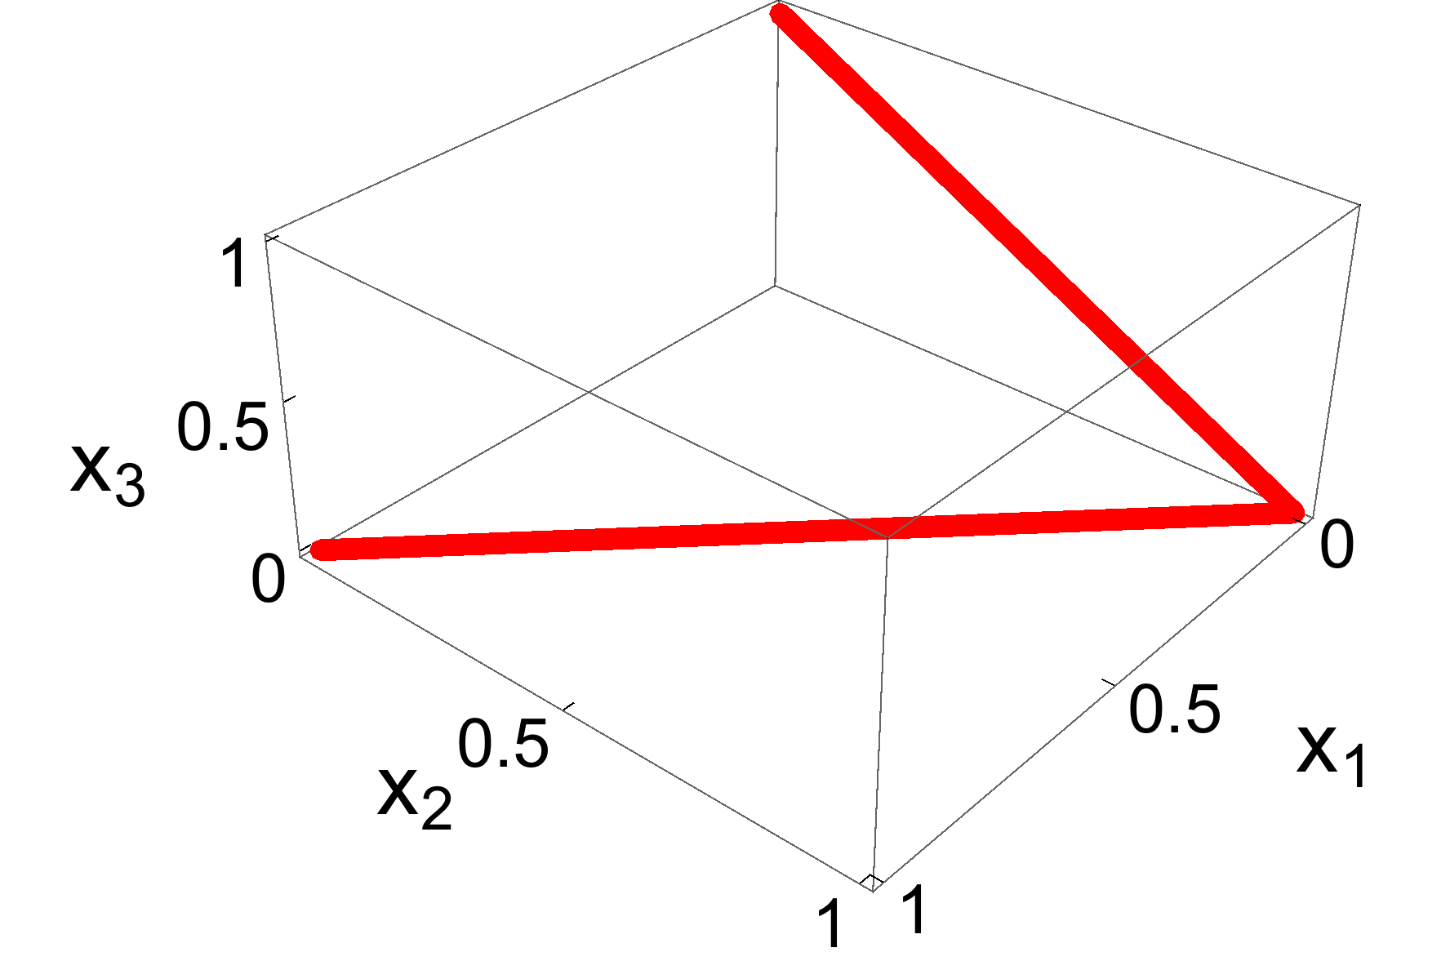
Special Ordered Sets of Type 2 (SOS2) =
Claim:

Slide 24
Embedding Formulation for SOS2: Part 1
From encodings to hyperplanes:
# non-bound facets = 2 × # of hyperplanes
Hyperplanes spanned by

Slide 25
Embedding Formulation for SOS2: Part 2
# non-bound facets = 2 × # of hyperplanes

Slide 26
Embedding Complexity for SOS2
Lower Bound:
Upper Bound:
Gray code:

Slide 27
Embedding Complexity for SOS2
Unary encoding (Padberg / Lee and Wilson, early 00’s):
Smallest Binary encoding (V. and Nemhauser ’08, Muldoon ’12):
Adding lower bounds (# hyperplanes ≥ dimension):

Slide 28
Validity of Formulation May Not Be Evident
# non-bound facets = 2 × # of hyperplanes

Slide 29
Validity of Formulation May Not Be Evident

Slide 30
Validity of Formulation May Not Be Evident

Slide 31
Abstraction Works for Multivariate Functions

Slide 32
Formulations and Complexity for Triangulations
Lower bound:
Size of unary formulation is: (Lee and Wilson ’01)
m
m
Small binary formulation for union jack triangulation of size: (V. and Nemhauser ’08)

Slide 33
Encoding Selection Matters
Size of unary formulation is: (Lee and Wilson ’01)
General
Inequalities
Variable Bounds
Size of one binary formulation: (V. and Nemhauser ’08)
Right embedding = significant computational advantage over alternatives (Extended, Big-M, etc.)

Slide 34
Unary Encoding, Minkowski Sum and Cayley Trick

Slide 35
Faces of Cayley Embedding
Two types of facets (or faces):
Not all combinations of faces
Which ones are valid?

Slide 36
Valid Combinations = Common Normals

Slide 37
Redundancy in Embedding Formulations

Slide 38
Formulations and Complexity for Triangulations
Lower bound:
Size of unary formulation is: (Lee and Wilson ’01)
m
m
Small binary formulation for union jack triangulation of size: (V. and Nemhauser ’08)

Slide 39
What About Other Triangulations

Slide 40
Redundant Embedding Formulation
v/s 8 inequalities

